Slide 1

Team Project/Therac-26
Software Engineering
[Exaile Music Player]
Austin Baker
Christoph Samitsch
Jaime Miller
Joshua Walton

Slide 2
In the beginning…
Metalinks
Pidgin
Exaile
Notes:
Metalinks – Metalinks bundle the various ways to download a file like HTTP, FTP, and P2P , allowing the file to download from all of these ways using segmented downloading. This allows for “faster” downloads and is particularly useful for people with slower internet. The problem with this program was the lack of support and available code as the idea behind Metalinks was a technique to writing XML rather than a single program.
Pidgin – a chat client that allows a user to connect to various chat networks at the same time. The problem we had was that the program was written in C, so we shied away from it.
Exaile – finally found Exaile to be our final choice for our project.

Slide 3
What is Exaile?
A music player that allows one to:
  Listen to music
  Create playlists
  Get album artwork
  Get song lyrics
GTK+
Python
Notes:
Music player – appealed to us because we have all used iTunes.
GTK+ - a toolkit for creating graphical user interfaces.
Python – the majority of us were familiar with using this language, and it is also easy to learn.

Slide 4

Play music
Organize playlists
Set preferences
User
Notes:
Play music: To play music allows the user to listen to a song he or she has selected from the playlist. The user can pause, stop, restart the current song, start previous song, and start next song at any time while the current song is playing. It is assumed that the user has at least 2 songs in a playlist in order to use all the functions previously described.
Organize playlists: Organizing playlists allows the user to create new playlists or modify existing ones. In addition, he or she can create a series of folders and subfolders to categorize music as desired.
Set preferences: Setting preferences allows the user to customize the interface, letting him or her display certain information about a song including its lyrics, title and genre, and even location. In addition, certain functions can be enabled that permit a user to resume a song upon closing Exaile.

Slide 5
User
P: Playlist
G: GIO
PR: Provider
import_playlist(path)
content_type_guess(path)
import_from_file(path)
Playlist Type
Alt
Playlist
[Playlist Type OK]
[Playlist Type Fail]
InvalidPlaylistTypeError
('Invalid playlist type.')
Sequence diagram for importing a playlist
Notes:
1. The user starts by requesting the playlist he or she desires. An instance of the playlist, P, object class is created which has attributes to the user's playlist.
2. The instance is then used to make calls using different methods pertaining to the class. In this case, the user wants to import a playlist using the import_playlist method, passing it the file path to the playlist.
3. Following the import_playlist method, the content_type_guess method is called on a GIO object to determine the type of the playlist and it's file I/O. This object was used as a result of a switch to the GIO design by the developers because it provides an advantage to converting between uris and paths which could eliminate a lot of code duplication*.
4. With the data containing the playlist and its type, the import_from_file method is called on a Provider object to retrieve the file. It returns the playlist which is then checked to see if it is of a supported file type.
If the file type is supported, then the Playlist is returned to the user. If the file type is not supported, then an error message is returned.
* Exaile Team. Exaile Wiki: Blueprints: GIO. <http://www.exaile.org/wiki/Blueprints:GIO>.

Slide 6
Challenges in the beginning
Python
Interaction with GUI
Appropriate methods for test cases

Slide 7
Architectural Scheme
runAllTests.py
Clear Temp Directory
Import and run Test Case
Get Requirements
Write Result File

Slide 8
A Single Test Case
testCaseXY.py
Input
Call Unit
Write Output to Temp Folder
Compare Output with Oracle

Slide 9
Volume Test Case
Uses Exaile's Base Player
Simple test of volume functionality
  Does the volume set to the requested value?
  Will the player allow for values less than 0 or greater than 100?
Base player should set to the requested value every time

Slide 10
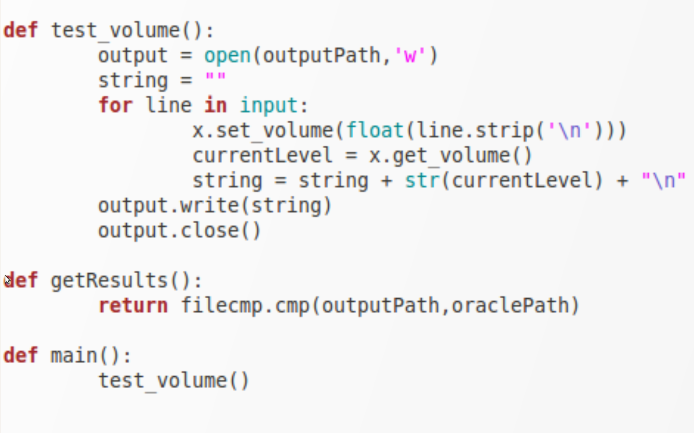
Volume Test Code

Slide 11
Track Rating
Uses Exaile's track class (“trax”)
creates a “trax” object
Tests the rating function for a given track
  Does Exaile actually set the requested value?
Exaile takes an integer between 1 and 5 as an input

Slide 12
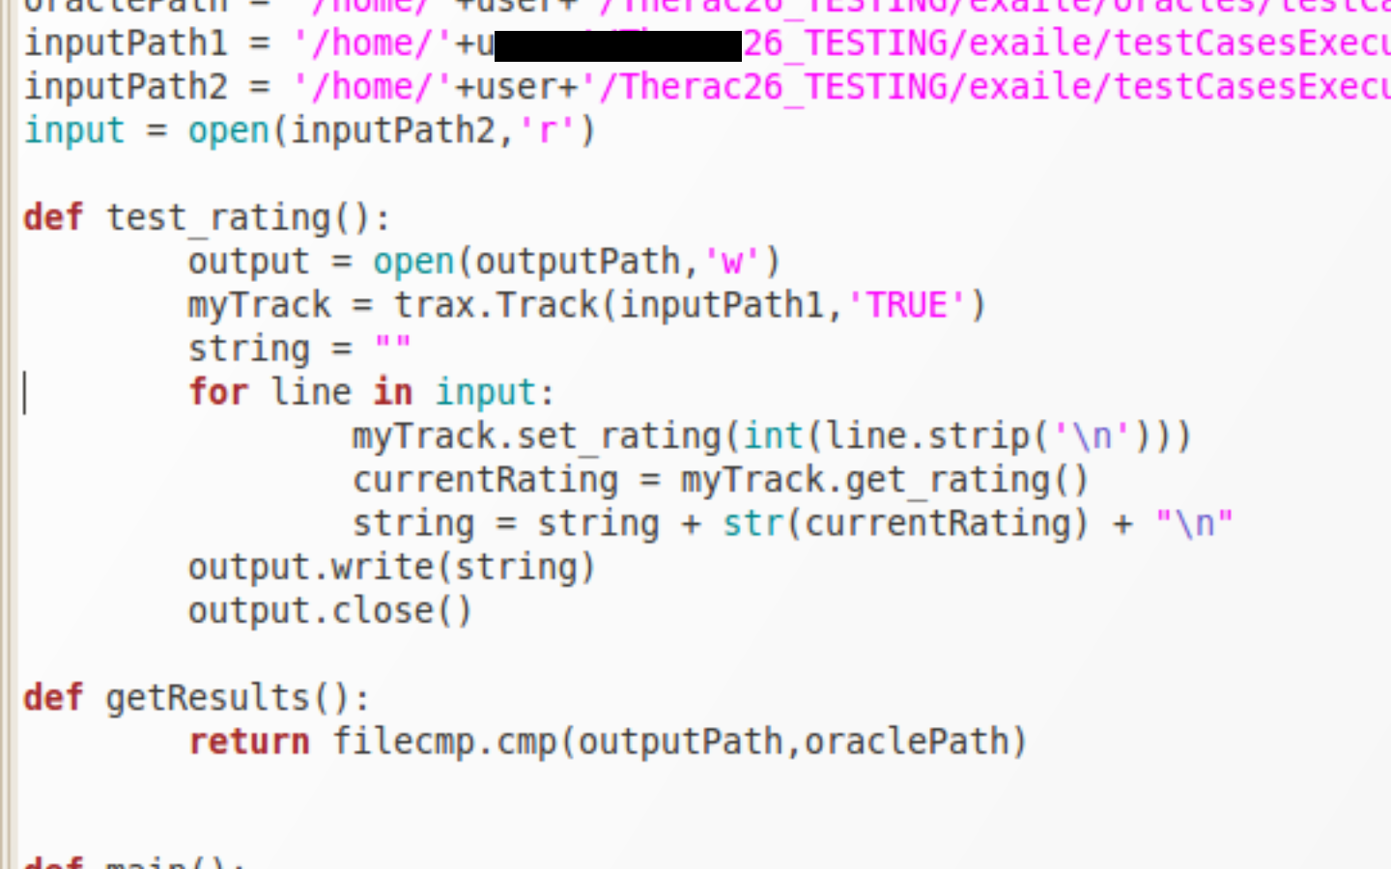
Track Rating Test Code

Slide 13
Track Cover Test Case
Tests using Exaile's “trax” class
Tests if the method will return a album cover
  If there is no cover, does it return false
Should return false since our input has no cover attributes.

Slide 14
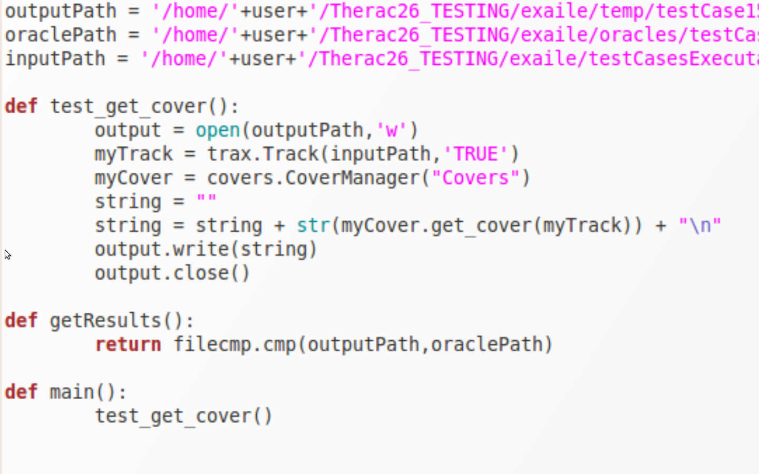
Track Cover Test Code

Slide 15
Issues with Implementation
Problem:
  Common paths on different systems
Solution:
  Using os.environ['USERNAME'] allows us to execute scripts from any user's home directory

Slide 16
Issues cont.
Problem:
  Importing from files higher in the folder hierarchy
Solution:
  We appended the path to our working directory for the tests to sys.path

Slide 17
Issues cont.
Problem:
  Clearing the temp directory before each run
Solution:
  A separate script lists the contents of the temp folder
  For every file that exists, it removes that file

Slide 18
Issues cont.
Problem:
  Numbering convention on testCases
  Each executable test case has a testNum variable with an int value
Solution:
  All of our testCases and testCasesExecutables files are named without leading zeros
  All test cases appended to an array using a for loop

Slide 19
Issues cont.
Problem:
  Making the runAllTests script run the tests created
Solution:
  The glob class's glob method returns the number of files specified by an extension in a given directory

Slide 20
Fault Injections
Test Case 1 – Setting the volume
  Requirements:
    Setting the volume with a specified value must set the volume to that value
  Inputs:
    Float values in increments of 1 from 0.0 to 101.0
  Expected Output:
    The same increments from 0.0 to 101.0
  Why this fails:
    The set_volume method converts the last volume value of 101.0 to 100.0

Slide 21
Fault Injections cont.
Test Case 5 – Setting a track rating
  Requirements:
    Setting the rating of a track to a specified value must set the rating to that value
  Inputs:
    Integer values in increments of 1 from 1 to 6
  Expected Output:
    The same increments from 1 to 6
  Why this fails:
    The set_rating method converts the out-of-range value of 6 to a 5

Slide 22
Fault Injections cont.
Test Case 9 – Next track in a playlist
  Requirements:
    The next command must increment current position of given playlist to the next position
  Inputs:
    A playlist with 5 tracks, range of 6 to invoke next command
  Expected Output:
    The playlist proceed to positions 1,2,3,4 and then repeat 4,4 since they are at the end of the playlist
  Why this fails:
    When reaching the end of the playlist, method loops around to the “beginning” going to positions -1 and 0

Slide 23
Fault Injections cont.
Test Case 10 – Previous track in a playlist
  Requirements:
    The previous command must decrement current position of given playlist to the previous position
  Inputs:
    A playlist with 5 tracks, current position of 4, range of 6 to invoke previous command
  Expected Output:
    The playlist should go back to positions 3,2,1,0,-1,4
  Why this fails:
    upon reaching the first track in the playlist, it simply repeats it, producing positions 3,2,1,0,0,0

Slide 24
Fault Injections cont.
Test Case 16 – Splitting numerical values
  Requirements:
    The split_numerical method must separate the numbers value in format n/n to a tuple (n,n)
  Inputs:
    Blank values for the input “ / ”
  Expected Output:
    Either (0,0) or (None,None)
  Why this fails:
    A blank input produces (None, 0)

Slide 25
Lessons learned and Conclusion
Linux based systems
  ubuntu
Python Coding
  PyUnit
  Python syntax
Overall development of a test framework
Tested much of Exaile's framework and able to contribute to Exaile project

